Slide 1
De Dolfijnen Spotters
Team 4: Jasper, Kimberley, Mounir en Ramses

Slide 2
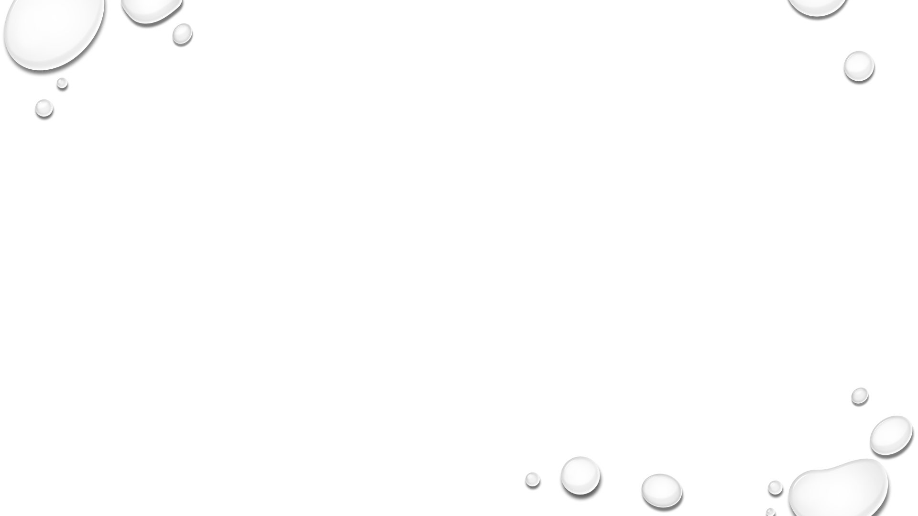
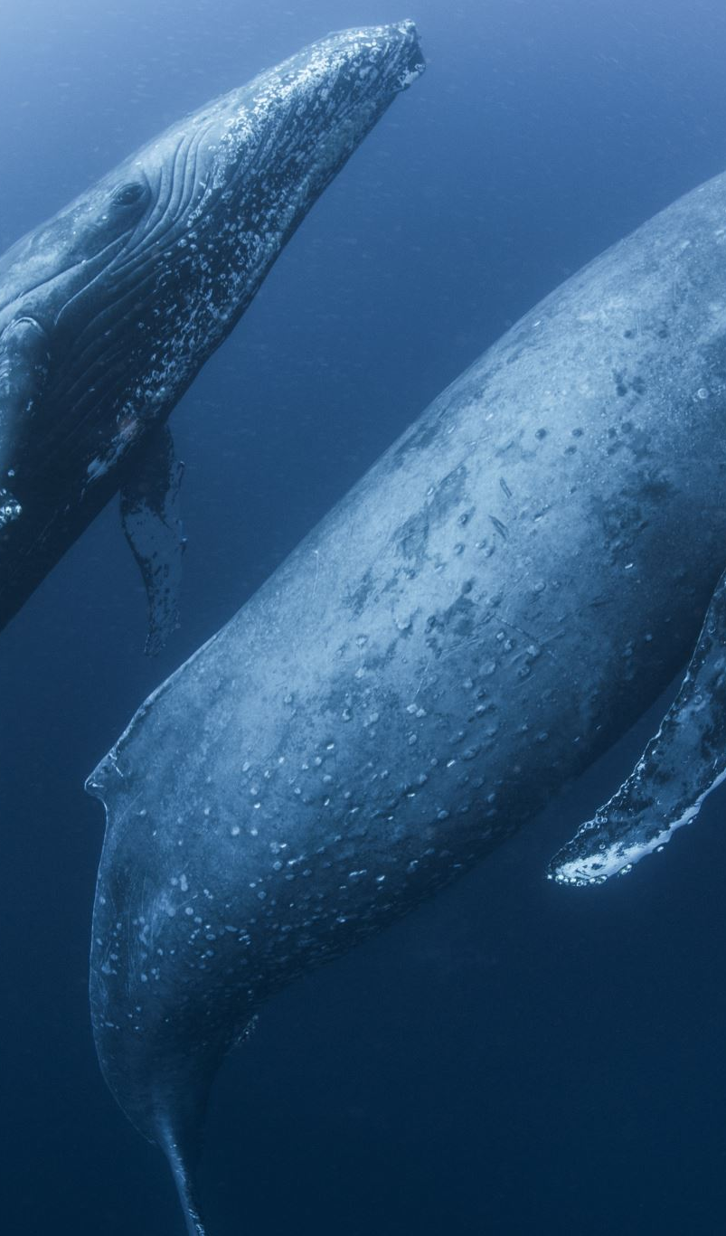
Data exploration
Properties of the pictures
color
Size and dimensions
Dolhpins and whales
Dolphins and whales distribution
Individuals per Species
Photos per individuals

Slide 3
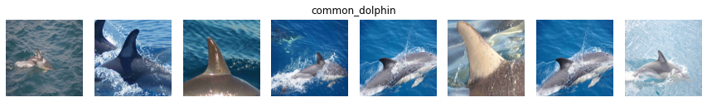
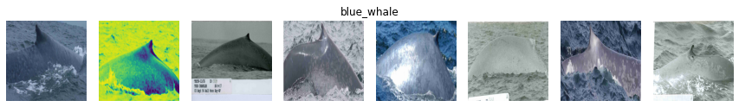
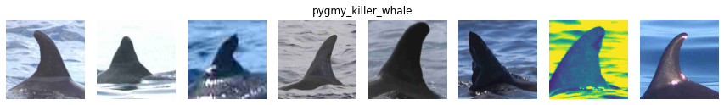
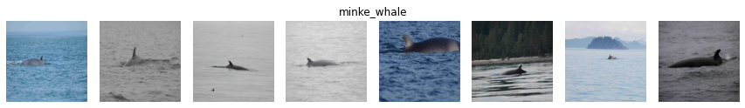
Color/dimensions

Slide 4
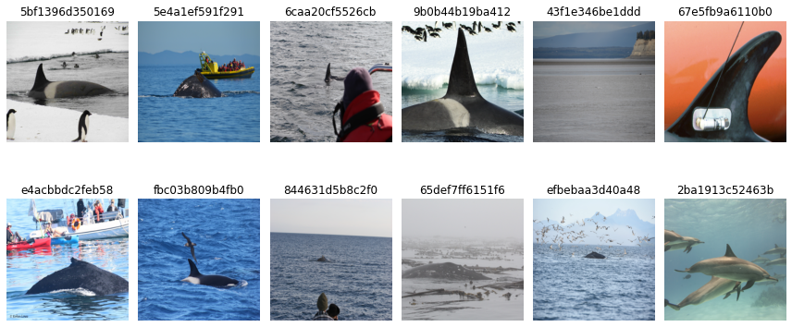
Abnormal images

Slide 5
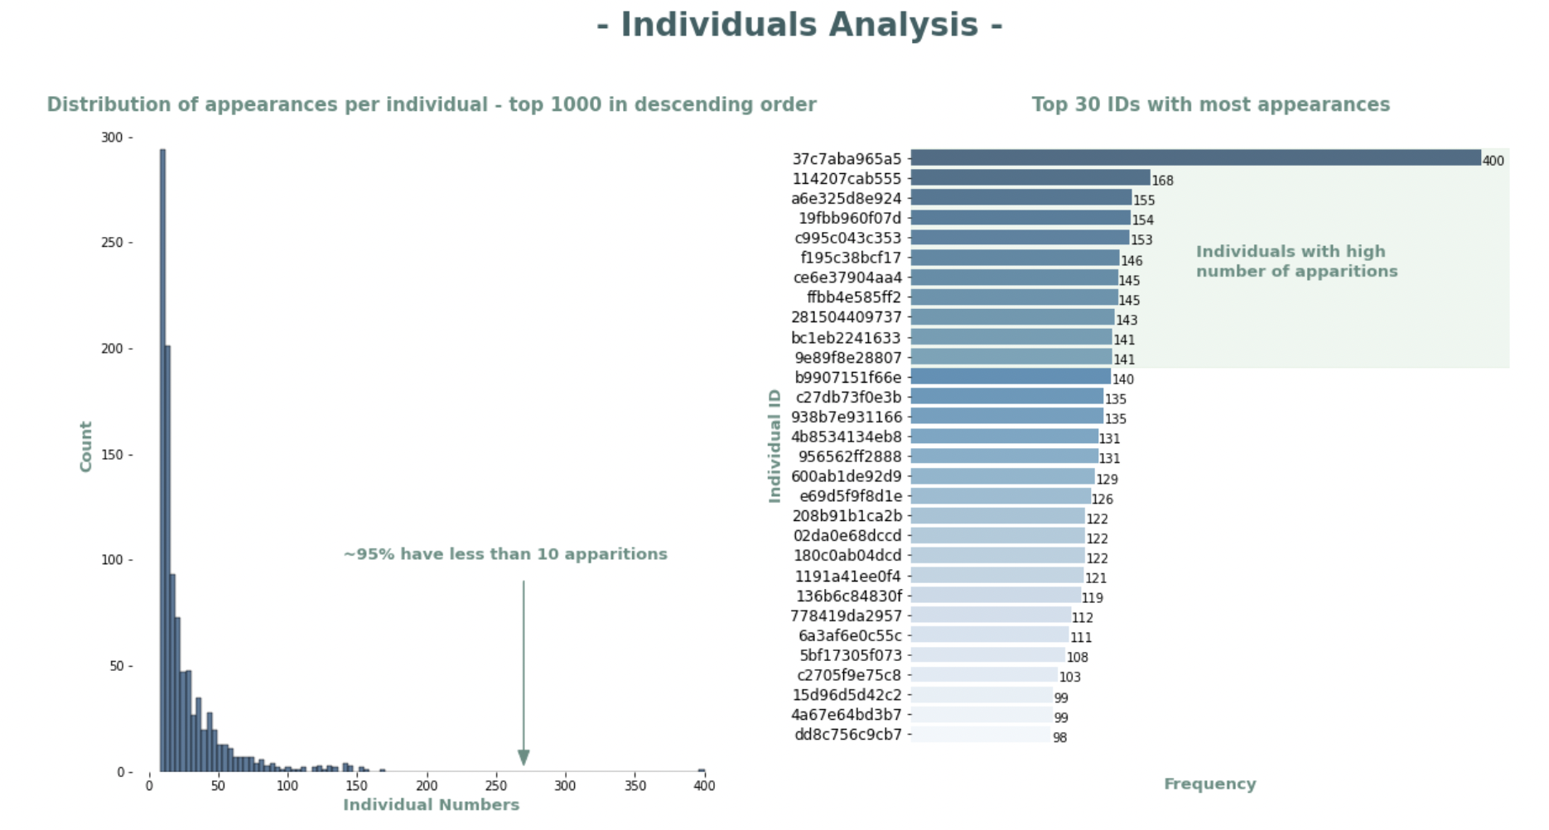
Data Exploration Individuals

Slide 6
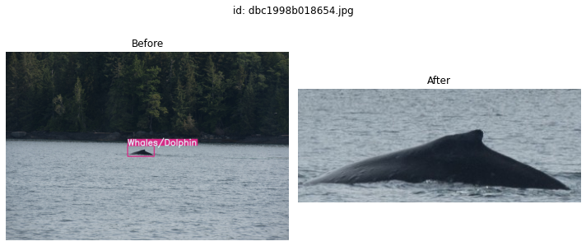
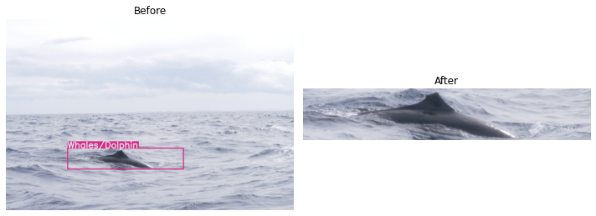
Data preprocessing
Resize and crop images
YoloV5 for object detection, use this for cropping

Slide 7
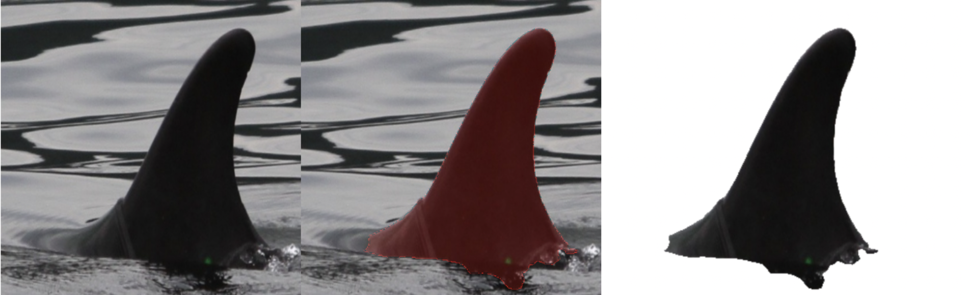
Data preprocessing
Cool idea: remove the background

Slide 8
Data Processing
Make all images the same size/color/...
Convert image to vector (embedding)
Cosine between image-vectors
Smaller angle between vectors = closer together in multi-dimensional space

Slide 9
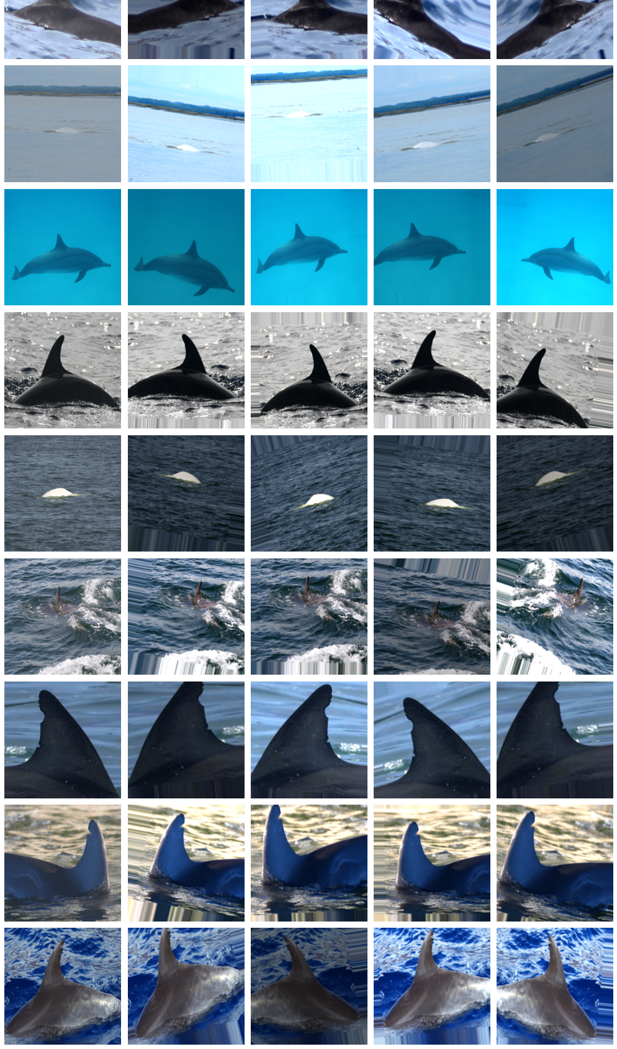
Data augmentation
Data augmentation technique is used to prevent the model from overfitting by showing same image multiple time with slight modification. We will be using keras's built in ImageDataGenerator to augment out training images

Slide 10
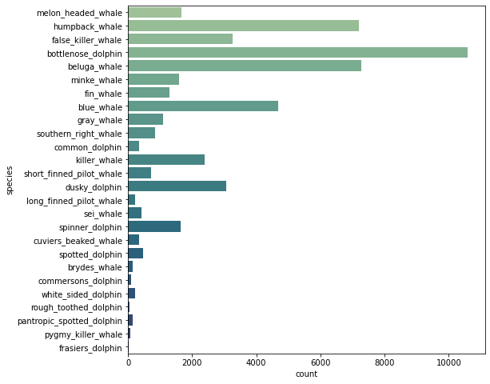
Visualize + Explainable AI

Slide 11
Teamwork
Github Trunk based development
Agile team
Close collaboration

Slide 12
Neat Pseudo Code
Tests?? What are those?
Code is pseudo neat

Slide 13
We vinden het dol fijn dat je luisterde

